Slide 1
Strategies to Enhance Social Work Student Writing Skills
Dona Young, MA (Curriculum and Instruction)
English Department, Indiana University Northwest
Andrea Tamburro, EdD, MSW,
BSW Program Director, Indiana University Northwest
Marshelia Harris, MSW
BSW Field Coordinator, Indiana University Northwest

Slide 2
Our Process – Our Team
Dona
Marshelia
Andrea

Slide 3
Supporting Evidence
Social work student writing skills are in decline (Alter & Adkins, 2001).
The National Commission on Writing study (2003) showed that teaching and practicing writing has diminished throughout school and college.
The Council on Social Work Education requires social work graduates be competent writers (2010).

Slide 4
Our Goals . . . Our Plan
To provide . . .
Approaches to assist students to write professionally.
Tools to enhance the writing process (compose freely and edit effectively).
Strategies, activities, and resources to enhance student writing and critical thinking skills.

Slide 5

What Writing Issues Do Your Students Have?

Slide 6
Writing Struggles
Learning gaps:
  Basic grammar, punctuation, spelling
  Sentence structure
  Word usage
Writing as Process:
  Getting words on paper—composing freely
  Knowing now to edit—getting past editor’s block
  Respecting the phases of writing (composing, editing, revising), allowing time for each and time in between
Writing style:
  Wordy, overly passive, difficult to understand
  Lacking ability to adapt to audience
  Lacking skill with professional language and documentation

Slide 7
Critical Thinking and Writing
  Developing evidence-based arguments
  Reflecting from various perspectives
  Providing breadth and depth
  Being precise, relevant, fair, accurate, and clear
  http://www.criticalthinking.org/pages/universal-intellectual-standards/527

Slide 8
What about the emotional aspects of learning (and teaching)?
Students have baggage with hopeful and fearful expectations.
Feeling inadequate, lacking confidence
Fearing mistakes and criticism
Speaking a dialect—and feeling shame
Feeling criticized
Feeling anger, devastation, and hopelessness
Transitions—beginnings and endings—are especially challenging.

Slide 9
  The issues seem overwhelming—
  Which learning theories can give insight into how we can help students at all levels?

Slide 10
Learning Theory
Taxonomy of Educational Objectives
Rhythm of Learning
Process, Practice, and Application
As we review these . . .
Where are the gaps in your curriculum?

Slide 11
The Taxonomy of
Educational Objectives (1984)
Knowing
Comprehending
Applying—the critical dividing line
Analyzing
Synthesizing
Evaluating
Have you ever wondered how a student can write a brilliant doctoral thesis but not understand what a sentence is—or isn’t?
Learners must develop competency in each content area.
Bloom, B. (Ed.). (1984). The taxonomy of educational objectives. Boston, MA: Addison Wesley Publishing Company.

Slide 12
Whitehead’s Rhythm of Learning (1967)
A cyclical process . . .
Romance: Invite fun and exploration
into the learning environment
Precision: Practice, Practice, Practice
Generalization: Apply principles and concepts
to real-world situations
To explore the power of practice, see Malcolm Gladwell’s The Outliers: The Story of Success (2011). However, student motivation is key to all success: What does “trying too hard” mean?
Whitehead, A. N. (1967). The aims of education. New York, NY: Free Press.

Slide 13
Words of Wisdom
To improve learning, it’s not necessarily doing better the things you are already doing, but sometimes it’s beginning to do things that you are not doing at all.
The tendency is to think of most subjects as giving answers, and that is not primarily what ought to be . . . but rather for the learner to see the principles that are useful and try to get answers for themselves.

Slide 14
Knowledge is created by the person who is using it, and thus that knowledge can only be transferred insofar as the ideas become active in the mind and actions of the learner.
—Ralph W. Tyler
We think of the arts as being creative—but learning itself is a creative process . . . a process of creating.

Slide 15
Learning as a process of creating . . .
What is a process approach with writing?
How does a process approach differ from a traditional approach?
  What methods support process?
How does the taxonomy fit?
What about the rhythm of learning?

Slide 16
Writing as Process
Stages of writing
Prewriting: identifying purpose and focus
  Mind maps, page maps, templates, scratch outlines
Composing: creating, inventing, discovering
  Writing freely until the writer finds his/her voice
  Developing the ability to summarize and paraphrase

Slide 17
Editing: making stylistic changes so that writing is clear and concise
  Adapting for purpose and audience
  Developing skill in grammar, punctuation, word usage as well as active voice, conciseness, parallel structure

Slide 18
Revising—a re-visioning process:
  Rethinking, questioning, rewriting, and re-creating.
  Revising is recursive:
  revising is a cyclical process
  As a cyclical process, revising requires the writer to recycle thinking to see the see material with fresh eyes and an open mind and set new priorities to restructure the content.

Slide 19
Methods
Analyze your curriculum design:
Content Areas
  Language Arts (Writing and Speaking)
  Social Work
Assessment—Pre-Test/Post-Test Approach
Practice
Application

Slide 20
Strategies
Connecting critical thinking and writing process
Learning to paraphrase—summarizing is the first step in learning to write freely
Using the DEAL Model for reflective thought
Using sentence prompts to build skill
Analyzing and deconstructing articles to build knowledge base:
  Thesis statements
  Themes
  Arguments
  Conclusion

Slide 21
Paraphrasing vs Plagiarizing
Summarizing and rephrasing what another person has written
Citing paraphrased information
Not just substituting a few words
Explaining how the ideas relate to the topic

Slide 22
Examples for Students:
Is this paraphrasing?
Original Text:
“Gambrill’s (2003) research indicates many gaps exist in the literature. Therefore, social workers must be actively involved in conducting and publishing research….” (Smith, 2014, p. 55)
Paraphrase Attempt:
Gambrill’s (2003) research shows that there are many gaps in the literature. Social workers need to be conducting and publishing research (Smith, 2014).

Slide 23
Is this paraphrasing?
Original Text:
“Gambrill’s (2003) research indicates many gaps exist in the literature. Therefore, social workers must be actively involved in conducting and publishing research….” (Smith, 2014, p. 55)
Paraphrase Attempt:
According to Gambrill (2003), social workers inform their practice with research. Unfortunately, there are many unanswered research questions (Smith, 2014).

Slide 24
Is this paraphrasing?
Original Text:
“Synthesis involves putting together elements or parts to form a whole, arranging or combining pieces, parts, elements…to develop a pattern or structure that was not clearly there before” (Jones, 2014, p. 80).
Paraphrase Attempt:
To synthesize is to create, innovate, and invent. Synthesizing involves integrating information a meaningful way (Jones, 2014).
Has this paraphrase demonstrated an understanding of the original concepts?

Slide 25
Is this paraphrasing?
Original Text:
“Synthesis involves putting together elements or parts to form a whole, arranging or combining pieces, parts, elements…to develop a pattern or structure that was not clearly there before” (Summer, 2014, p. 80).
Paraphrase Attempt:
When synthesizing a literature search, the writer identifies themes among the various articles (Summer, 2014). The authors may agree, disagree, or expand on the various themes.
In this example does the writer take the ideas of the original statement and combine it with other elements?

Slide 26
Sentence Prompts
Sentence prompts are used to teach critical writing skills.
Using sentence prompts is a legitimate way to structure ideas and is distinctly different from paraphrasing or plagiarizing.
The thesis / premise / central issue is . . . This study examines . . .
Some findings / conclusions are . . . he data suggest . . . The authors
assume . . . The research validates . . . Their research does not support . . .
Based on their research, the authors conclude . . .
Consensus among the researchers includes agreement about . . .
According to…. However,

Slide 27
Sentence Prompts
Smith (2003) | found observed | distinct significant notable considerable major only slight | differences between X and Y.
Jones (2013) found dramatic differences in the rate of decline of X between Y and Z.
Areas where significant differences have been found include X and Y.
The nervous systems of X are significantly different from those of Y in several key features
For a well-developed list of sentence prompts, visit Academic Phrasebank at http://www.phrasebank.manchester.ac.uk/.

Slide 28
DEAL Model
Structured Critical Reflection
What does “reflection” mean to you?
What is a critical reflection?
How would you write about your reflection?
What important points should be included in a critical written reflection?

Slide 29



They Wrote a Song About it!
    Reflection of the way life used to be Supremes 1967?
The Supremes were talking about what in this song?

Slide 30
Reflection is?
Reflection is “…active, persistent and careful consideration of any belief or supposed form of knowledge in the light of the grounds that support it and the further conclusions to which it tends” (Dewey, 1933).

Slide 31
Critical Reflection is?
Intertwined with critical social theory which is in keeping with social work values and ethics.
Critical reflection identifies power relationships and underlying assumptions about those relationships.
How do we help students learn to do this?

Slide 32
DEAL Model
“D” describe as objectively as possible a specific experience with academic content from coursework. The focus should be on establishing clarity, accuracy, and relevance.
“E” examine as closely as possible. Analyze & begin to Synthesize—breakdown or dissect (Bloom, 1956). The focus is on building depth and breath.
“AL” articulate learning process in writing. The focus is on conveying the what, why, an how, of the learning cycle. What did I learn? How did I learn it? Why did I learn it?

Slide 33
Application of the DEAL Model
Court Summaries
Social Histories
Client Intake Forms
Assessments
Treatment Plans
Case Notes
Client Charts

Slide 34
Analyzing and Deconstructing Articles
Selecting an article
  What criteria would you use?
Review
  What would you review with students?

Slide 35
Guidelines for Curriculum Design
Start with an assessment.
Apply the taxonomy:
  Identify learning gaps.
  Present workshops or individual learning plans.
Use the rhythm of learning to spark motivation, taking pressure off at key points in the cycle.
Focus on process—how can a project become more than its outcome? How can you enhance the process?
Build process tools and activities into your design, such as the DEAL Model and paraphrasing activities

Slide 36
Application
What changes can you make in your classroom design to enhance writing skills?
What activities can you add?
What strategies can you build into your curriculum?

Slide 37

Questions

Slide 38
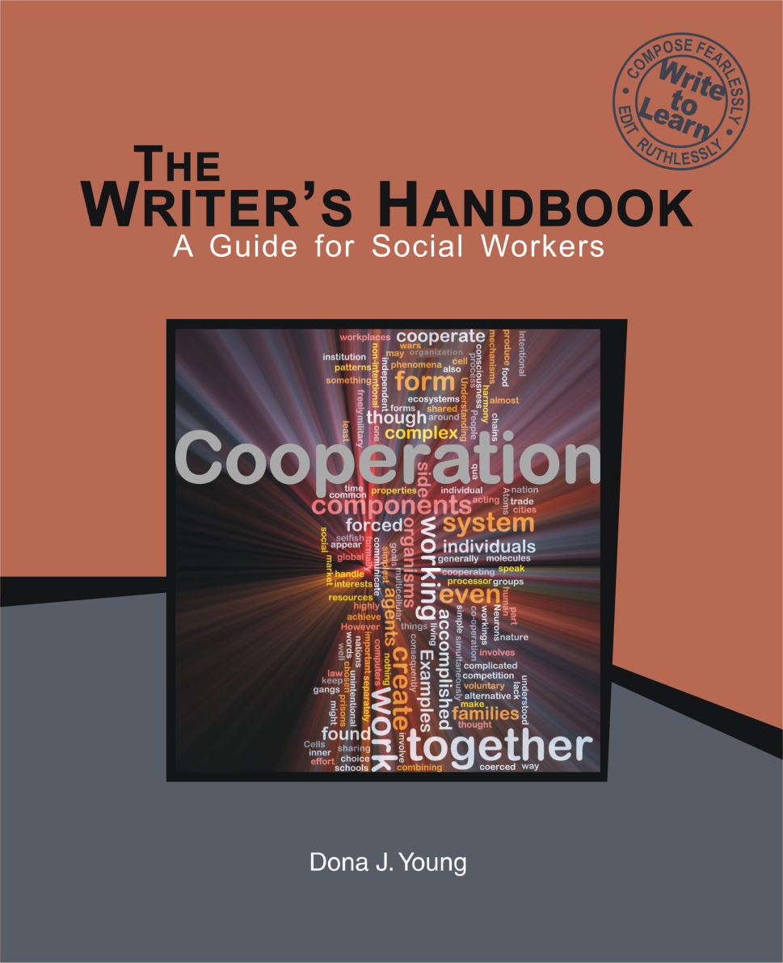
Stop by and see us ….
Please contact us at:
Dona J. Young
dona.young@earthlink.net
219.763.9794
Andrea Tamburro
atamburr@iun.edu
219.980.6703
Marshelia Harris
mdharris@iun.edu
219.981.5630

Slide 39
About the Authors
Dona Young, MA, teaches professional writing online at Indiana University Northwest. She earned an MA in education from The University of Chicago and a BA in sociology from Northern Illinois University, with minors in secondary education and business education. Young believes that writing is a powerful learning tool and that learning shapes our lives; she is also the author of the following textbooks: Business Communication and Writing (Writer’s Toolkit Publishing, 2012), Business English (McGraw-Hill Higher Education, 2008), and Foundations of Business Communication (McGraw-Hill Irwin, 2006), among others.
Andrea Tamburro, Ed.D. and MSW, is a member of the Shawnee Tribe and is the Bachelor of Social Work Program Director at Indiana University on the Northwest campus. She teaches policy, research, and practice. She earned her education doctorate from Simon Fraser University in British Columbia, Canada, and her master of social work through the University of Iowa. Dr. Tamburro’s main research area is indigenous social work education; her practice areas include child welfare, mental health, domestic violence, and criminal justice.
Marshelia Harris, MSW, teaches policy, administration, and child welfare across the bachelor and master of social work programs at Indiana University Northwest. Harris received her MSW from Indiana University Northwest and BS in graphic arts management from Indiana State University. She is a licensed child welfare specialist with the state of Illinois and has several years of administrative experience in social services. Harris has developed new programs, facilitated training sessions, and managed parenting and non-parenting youth programs, case management and clinical services, and program budgets.

Slide 40
References
Alter, C., & Adkins, C. (2001). Improving the writing skills of social work students. [Article]. Journal of Social Work Education, 37(3), 493-505.
Ash, S.L. & Clayton, P.H. (2004). The articulated learning: An approach to guided reflection and assessment. Innovative Higher Education, 29(2), 137-154.
Baum, N. (2012). Reflective Writing Assignment to Help Social Work Trainees Work through Poor Supervisory Relationships. [Article]. Social Work Education, 31(1), 110-124. doi: 10.1080/02615479.2010.539604
Bell, S. (2010). Project-Based Learning for the 21st Century: Skills for the Future. [Article]. Clearing House, 83(2), 39-43. doi: 10.1080/00098650903505415
Bloom, B. (Ed.). (1984). The taxonomy of educational objectives. Boston, MA: Addison Wesley Publishing Company.
Gladwell, M. (2011). The outliers: The story of success. New York, NY: Back Bay Books.
Dewey, J. (1910). How we think. Boston: D.C. Heath.
CSWE. (2010). Educational Policy and Accreditation Standards Retrieved December 15, 2010, from http://www.cswe.org/File.aspx?id=13780
Graham, S., & R. Harris, K. (2000). The Role of Self-Regulation and Transcription Skills in Writing and Writing Development. [Article]. Educational Psychologist, 35(1), 3-12.

Slide 41
References
Grise-Owens, E., & Crum, K. (2012). Teaching writing as a professional practice skill: A curricular case example [Article]. Journal of Social Work Education, 48(3), 517-536. doi: 10.5175/JSWE.2012.201000030
Johnstone, K. M., Ashbaugh, H., & Warfield, T. D. (2002). Effects of repeated practice and contextual-writing experiences on college students' writing skills. Journal of Educational Psychology, 94(2), 305-315. doi: 10.1037/0022-0663.94.2.305
Kellogg, R. T., & Whiteford, A. P. (2009). Training Advanced Writing Skills: The Case for Deliberate Practice. [Article]. Educational Psychologist, 44(4), 250-266. doi: 10.1080/00461520903213600
Martinez, C. T., Kock, N., & Cass, J. (2011). Pain and Pleasure in Short Essay Writing: Factors Predicting University Students' Writing Anxiety and Writing Self-Efficacy. [Article]. Journal of Adolescent & Adult Literacy, 54(5), 351-360. doi: 10.1598/JAAL.54.5.5McGuire, L, & Lay, K. (2012). DEAL Model of structured critical reflection.
McGuire, L, & Lay, K. (2012). DEAL Model of structured critical reflection.
Whitehead, A. N. (1967). The aims of education. New York, NY: Free Press.
Young, D. J. (2014). The writer's handbook: A guide for social workers. Ogden Dunes, IN: Writer's Toolkit Publishing

